Slide 1


Slide 2

Project Title < Derma Elixir Studio>

Slide 3
Group Members Introduction
Group Id:
< F24PROJECTA2BFA (BC210421957) >
Name: Rimsha Mukhatiar

Slide 4

INTRODUCTION OF PROJECT
Project Title: Derma Elixir Studio
Domain/Category: Web Programming
A web-based system developed for a skincare clinic in Islamabad running a welfare program.
Aims to offer free skin treatment services to underprivileged patients across Pakistan.
Provides an online platform for patient registration, appointment booking, and specialist interaction
Enhances accessibility to skin specialist information, available treatments, and clinic services.

Slide 5
Project Objectives
Allow only registered users (Patients and Skin Specialists) to access their respective dashboards.
Enable upload and verification of clearance certificates for free treatment eligibility.
Facilitate online appointment requests before visiting the clinic physically.
Allow Skin Specialists to access, update, and generate patient medical records and reports.
Provide a search feature for specialists, treatments, and skin concerns.
Collect and display verified patient feedback and reviews to improve service quality.
Display public information on homepage like About Us, Services, Treatments, and Contact details.

Slide 6
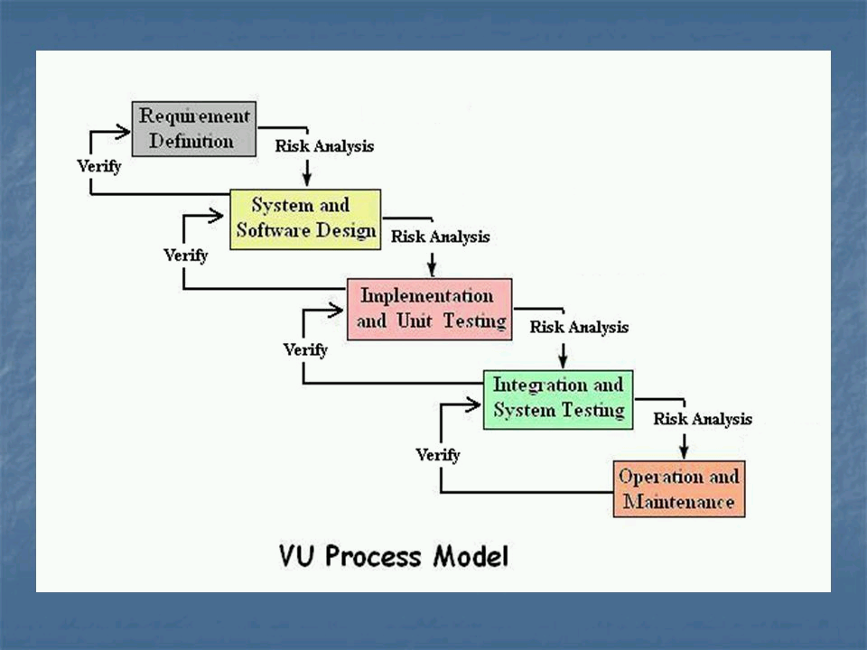
Process Model:
For the Derma Elixir Studio project, I adopted the VU Process Model as the development methodology. This model combines aspects of both the Waterfall and Spiral Models, providing a balance between structured planning and flexibility.

Slide 7
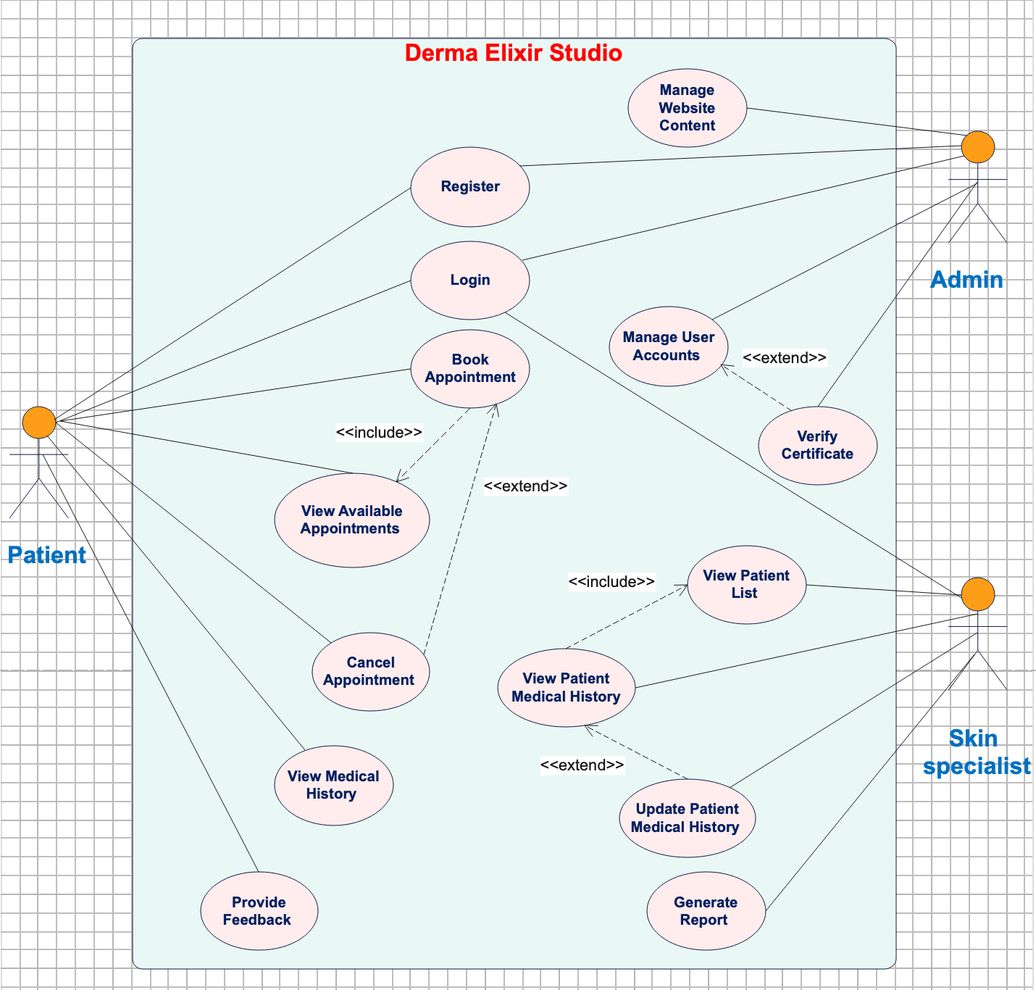
Use Case Diagram

Slide 8
Business Rules Catalog
Only registered users (patients and skin specialists) can access the system dashboard.
Users must upload a clearance certificate during registration to become eligible for free treatment.
The admin verifies the clearance certificate through the system before approving the user.
Only verified patients are allowed to book appointments with skin specialists.
The admin controls homepage content such as About Us, Services, Treatments, and Contact information.
Patients can request appointments online but must visit the clinic physically for consultation.
Skin specialists can view and update a patient's medical history, diagnosis, prescribed medicines, and lab test details.
Skin specialists have the option to generate reports based on patient records.
Only users who have completed appointments are allowed to submit feedback and reviews.
Verified reviews about specialists and services are displayed on the website homepage.
A search feature is provided to find skin specialists, skin concerns, and treatments easily.
Patient data is stored securely in the system and accessible only to authorized users.

Slide 9
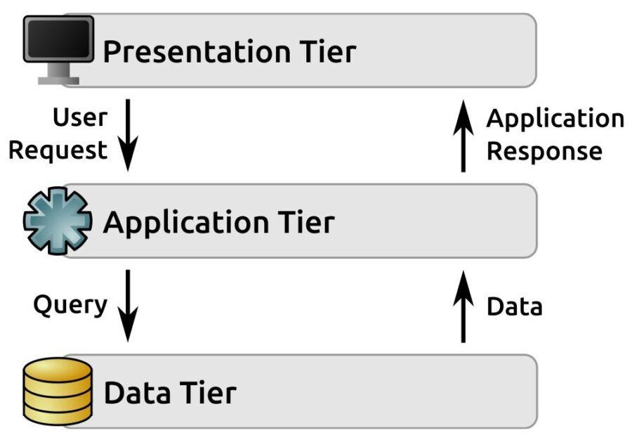
Architectural Design

Slide 10
Team Structure
👤 Project By: [Rimsha Mukhtiar]
Key Roles & Responsibilities:
Project Manager – Planned and managed project timeline and scope
Frontend Developer – Designed and developed the user interface using HTML, CSS, and JavaScript
Backend Developer – Handled server-side scripting and logic using PHP
Database Designer – Created and managed the MySQL database structure
Tester – Performed functional testing and debugging
Documentation Writer – Created all diagrams and project documentation (ERD, Use Cases, etc.)

Slide 11
📊 Diagrammatic View
[Rimsha Mukhtiar]
|
-----------------------------------------------------------------
| | | | |
PM Frontend Dev Backend Dev DB Designer Tester

Slide 12
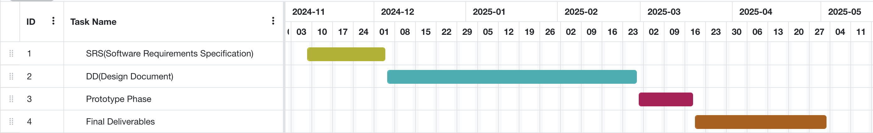
Project Schedule
Gantt Chart:

Slide 13
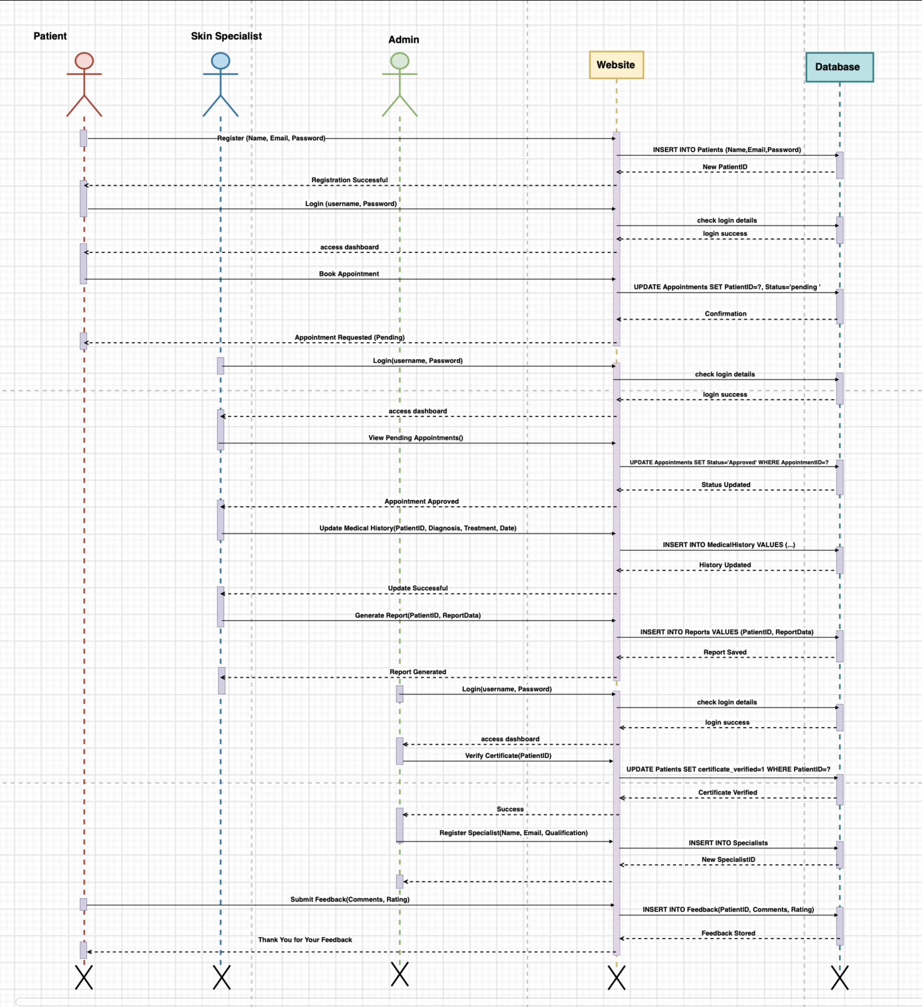
Sequence Diagrams

Slide 14
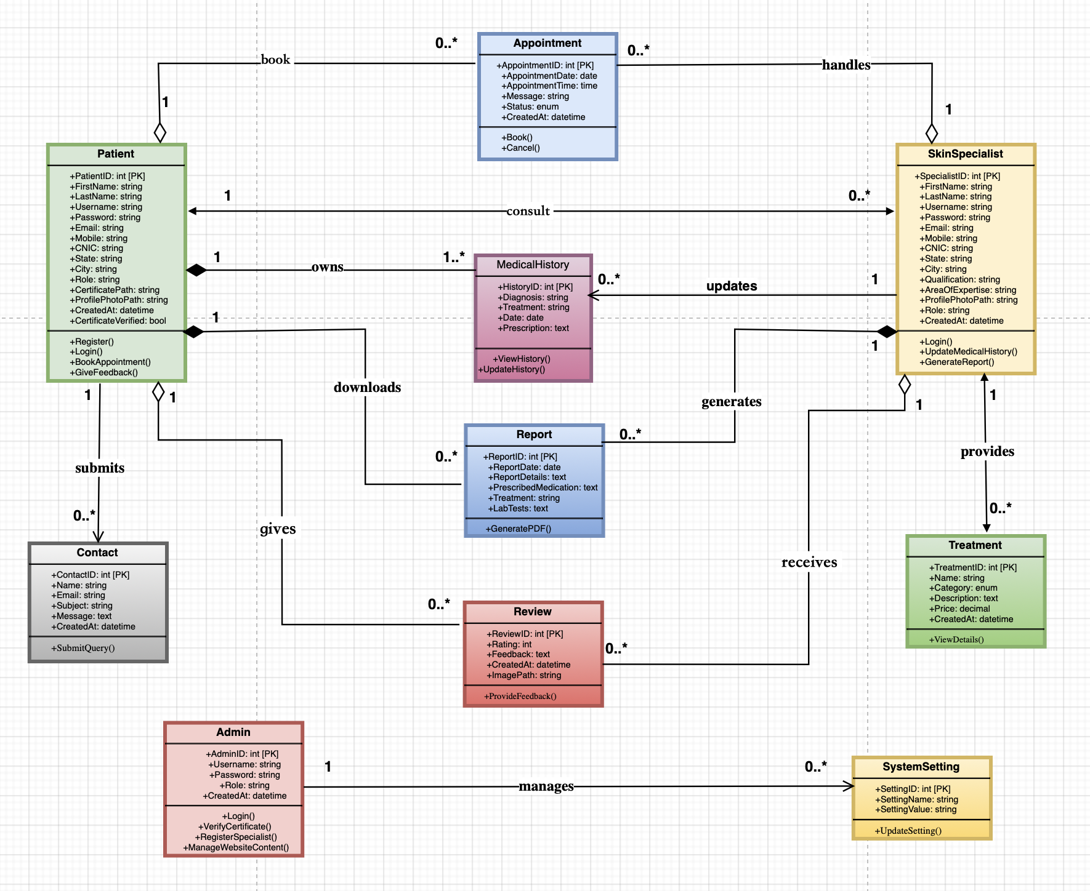
Logical Model/Class Diagram

Slide 15
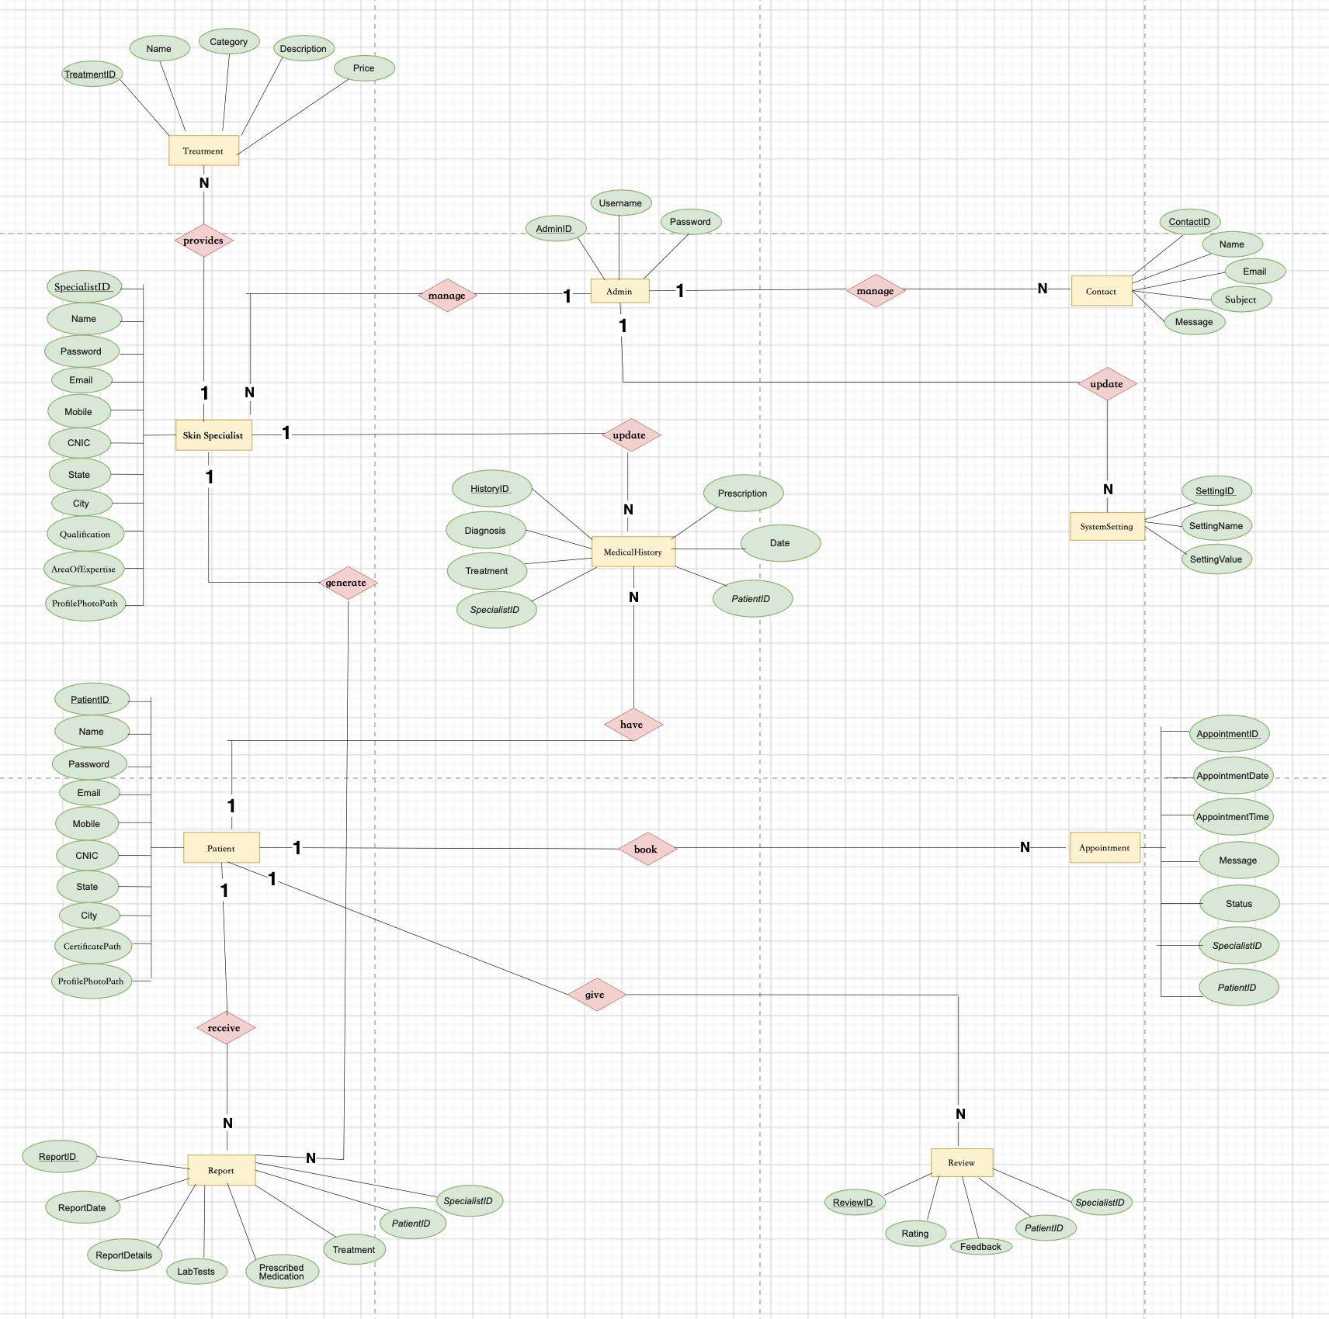
Entity-Relationship Diagram

Slide 16
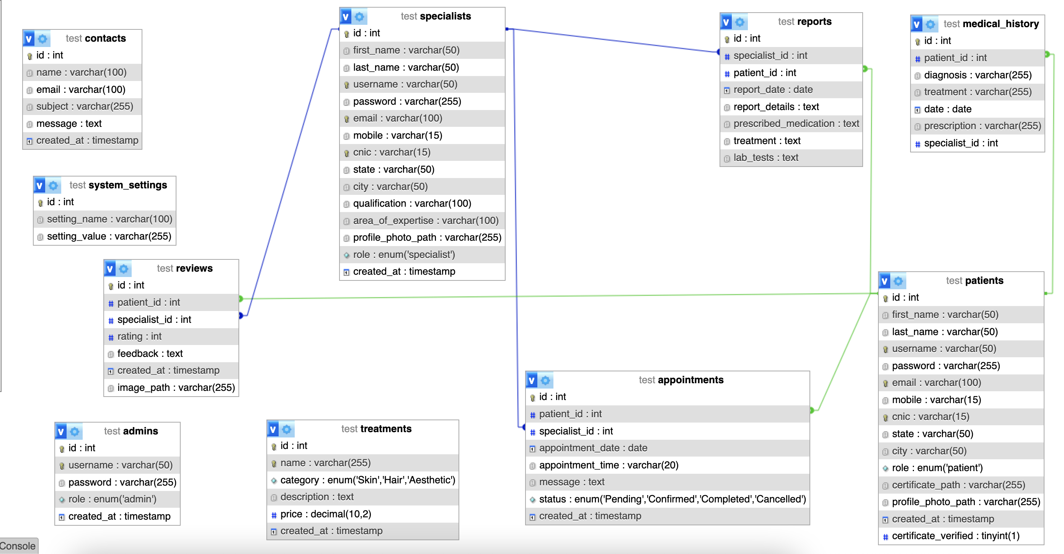
Database Diagram

Slide 17

User Interfaces
Home page:

Slide 18
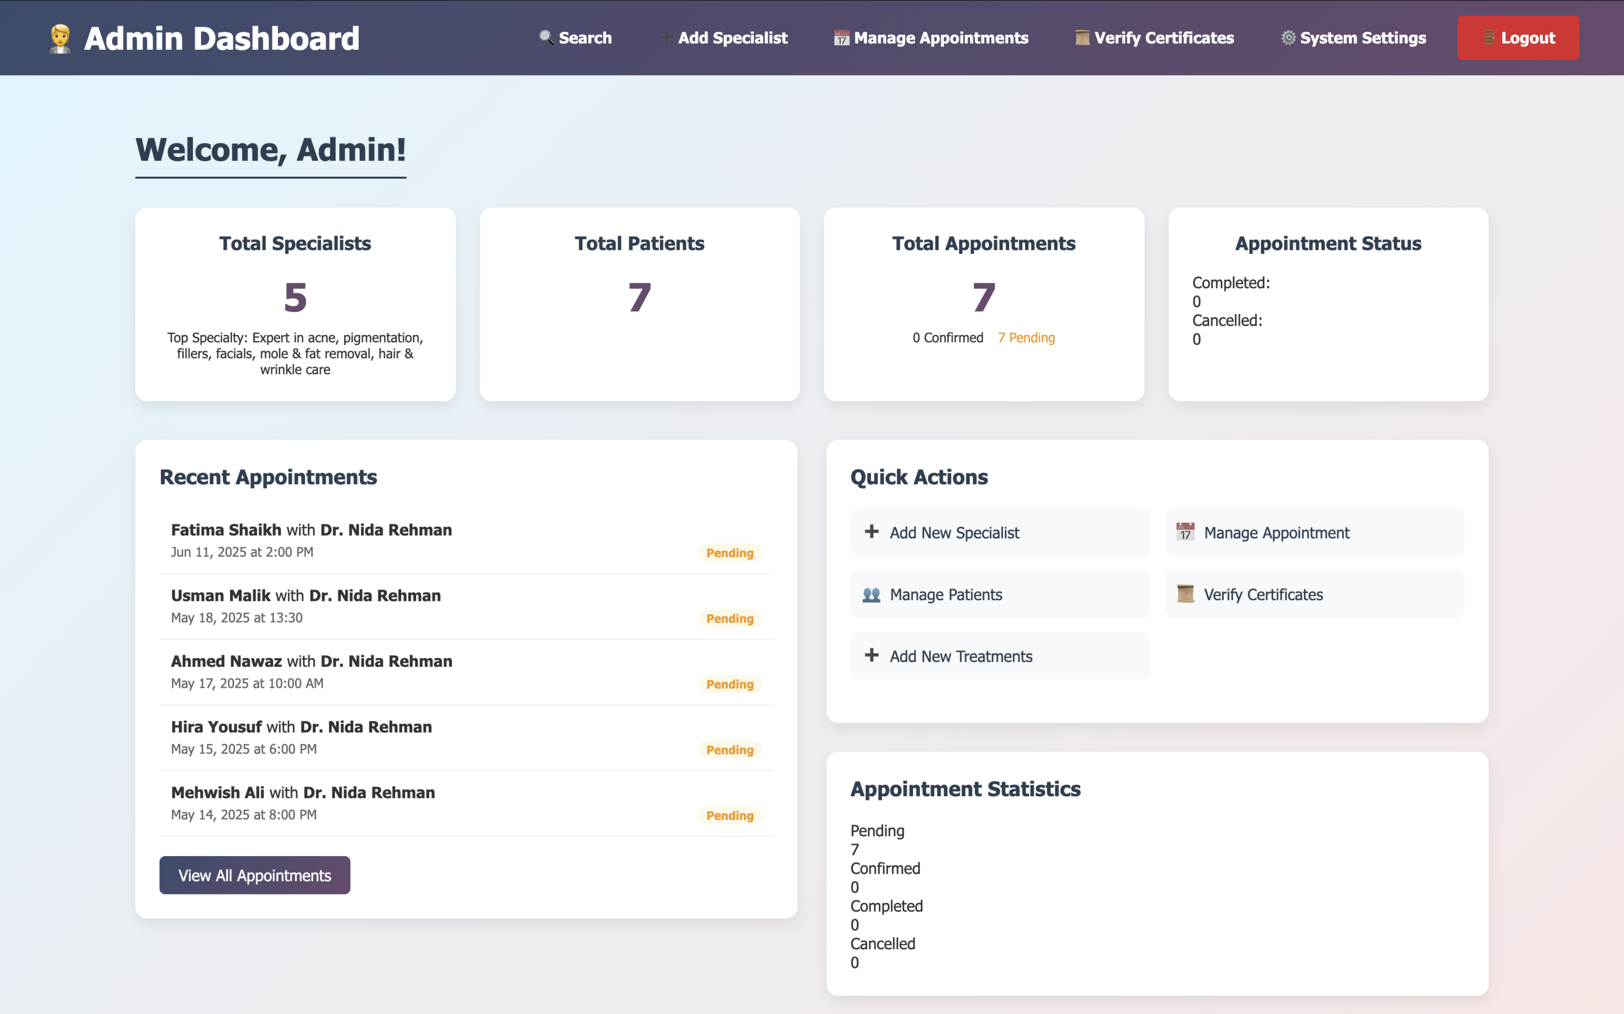
Admin Dashboard:

Slide 19
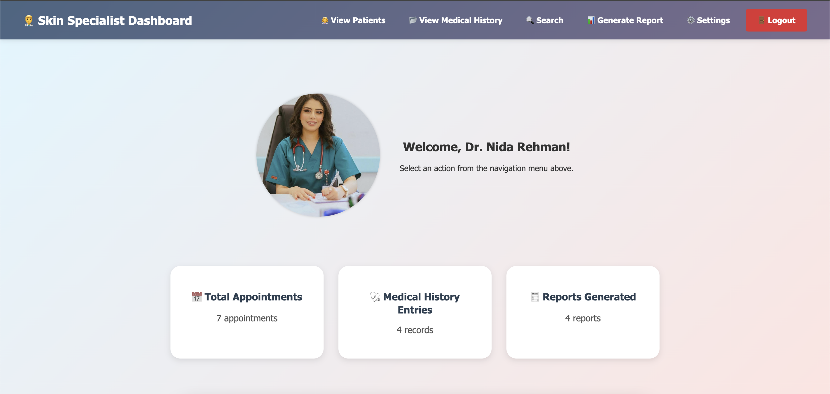
Specialist Dashboard:

Slide 20
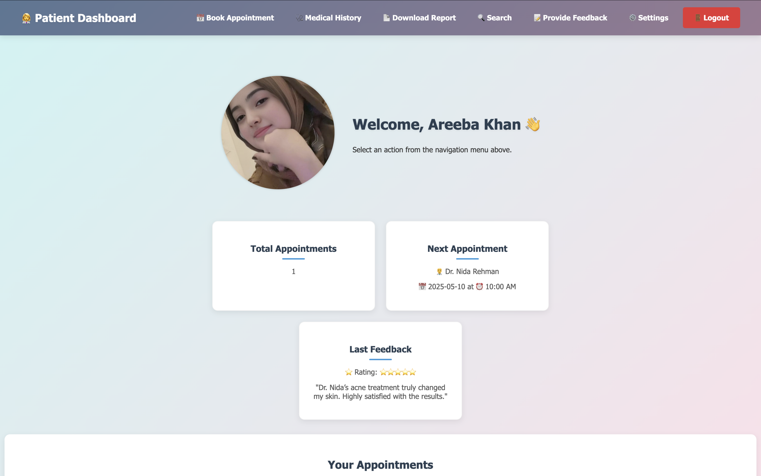
Patient Dashboard:

Slide 21
Tools
HTML5: Used to structure the content and layout of web pages.
CSS3: Applied for styling the user interface, including layout, colors, and animations.
JavaScript: Enabled interactive features and dynamic client-side functionality.
PHP: Used for server-side scripting, database interaction, and business logic implementation.
MySQL: Employed for database design and storage of user data, appointments, medical history, and feedback.
MAMP: Local server environment used to run and test PHP and MySQL code on Mac.
Visual Studio Code: Code editors used for developing and managing the project files.
EdrawMax: Utilized for drawing sequence diagrams, ER diagrams, and class diagrams.
Draw.io: Used for creating the architecture design diagram and other system design visuals.

